Slide 1
JSP CODES and OUPUT SNIPPETS

Slide 2
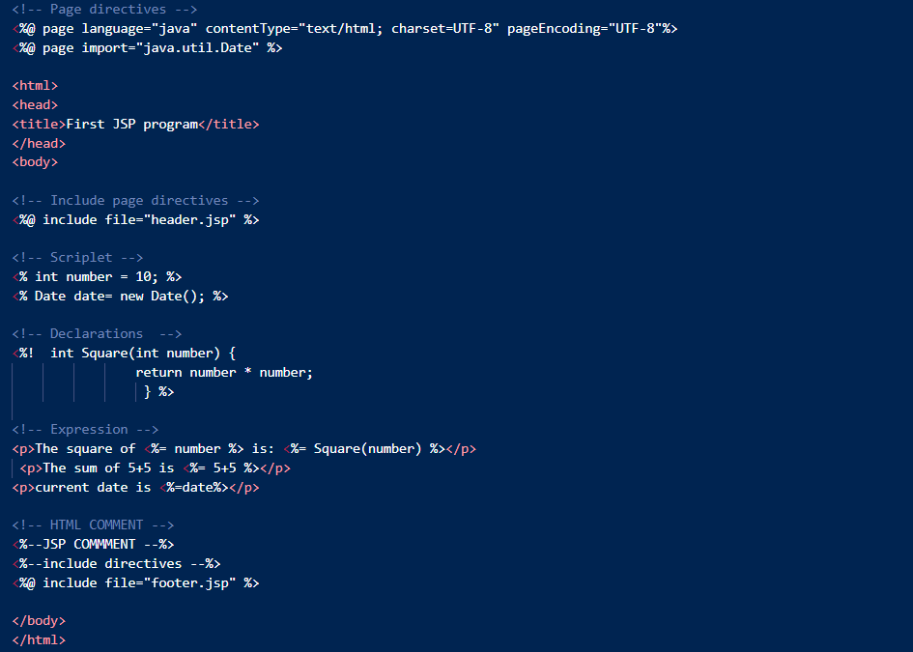
First.jsp (CODE)

Slide 3


header.jsp and footer.jsp (CODE)

Slide 4
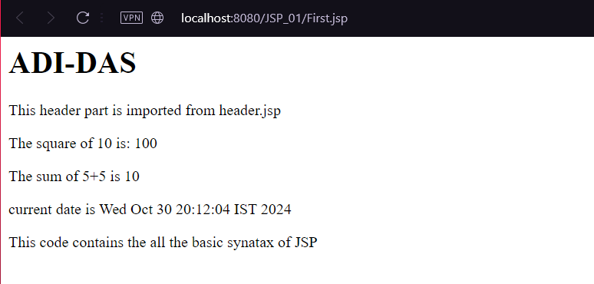
BASIC SYNTAX OF JSP (output)

Slide 5
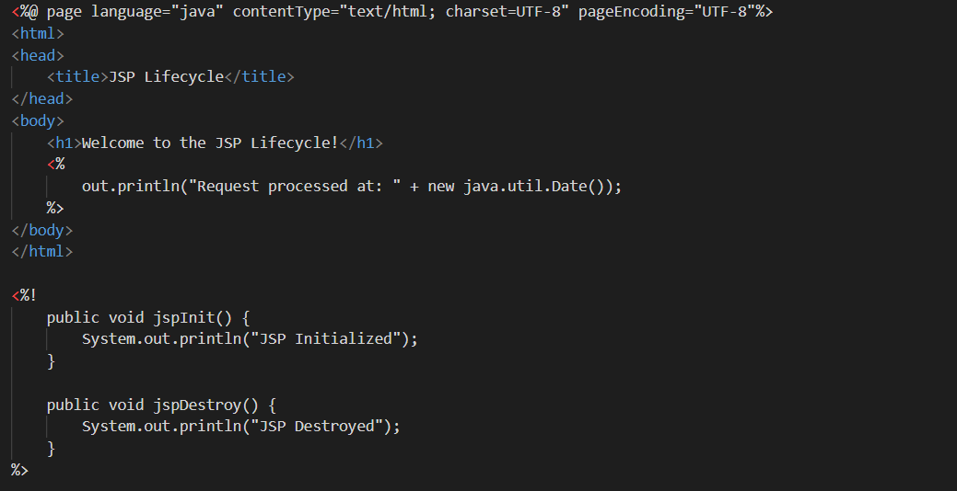
JSP_LC.jsp (CODE)

Slide 6
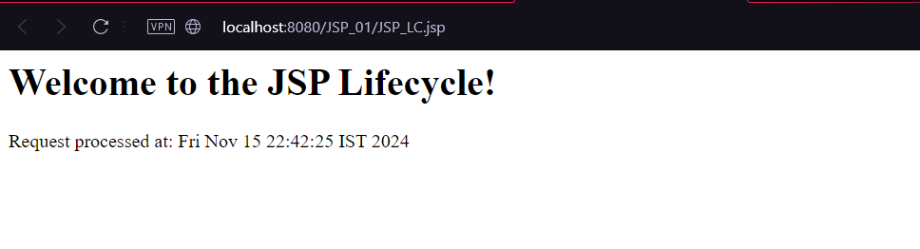
JSP_LC.jsp(output)

Slide 7
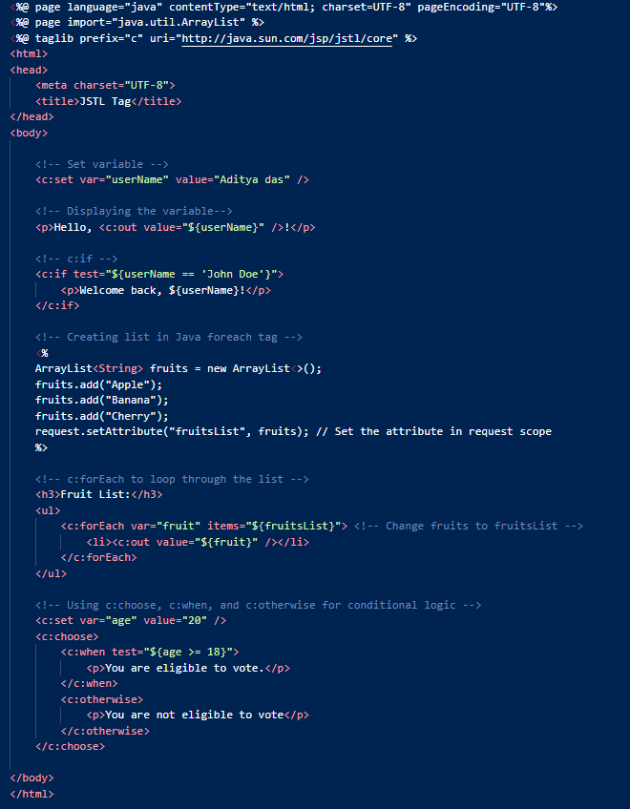
TAG_lib.jsp (Code)

Slide 8
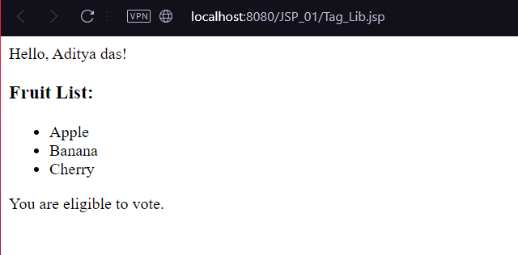
TAG_lib.jsp (output)

Slide 9
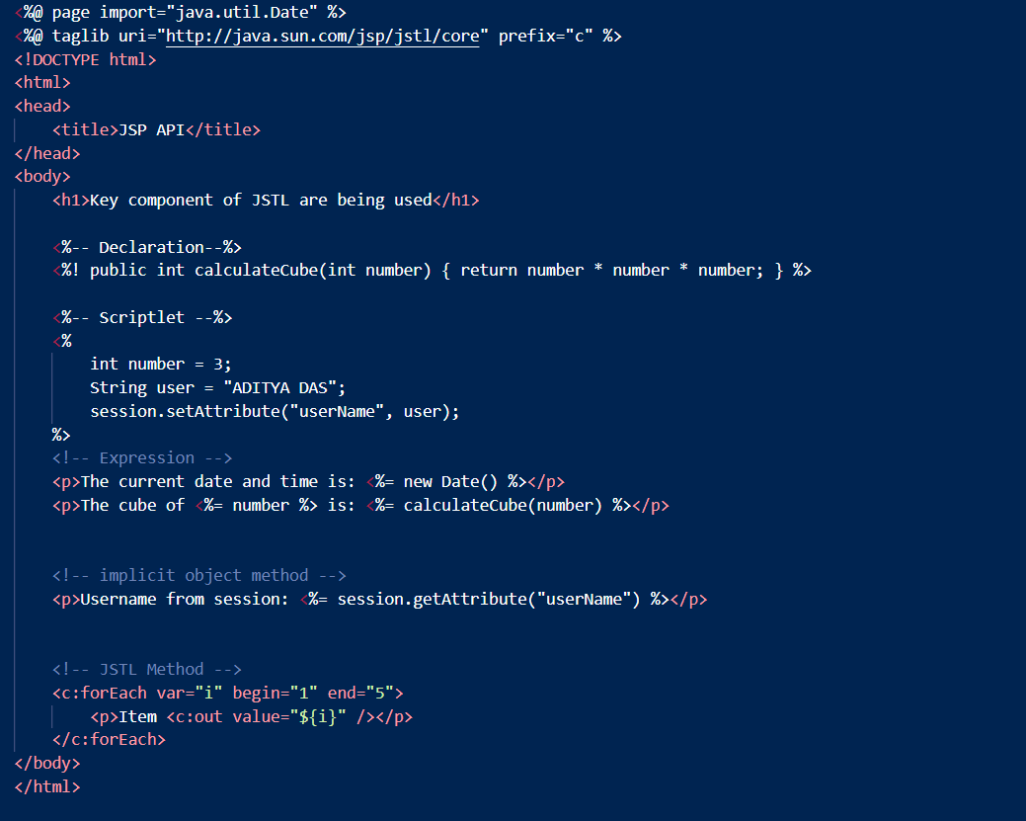
JSP_API.jsp (CODE)

Slide 10
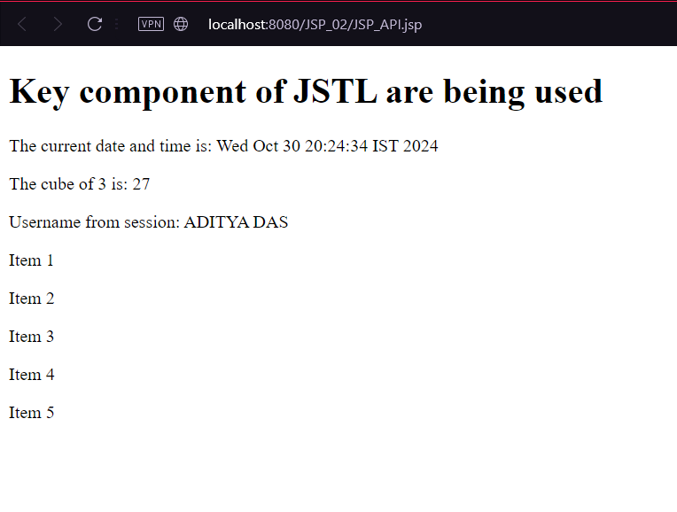
JSP_API.jsp (output)

Slide 11
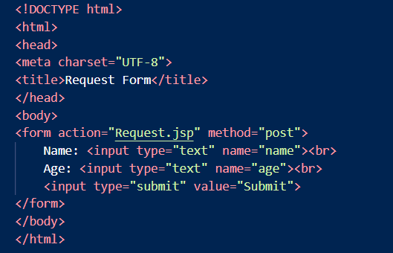
index.html (CODE)

Slide 12
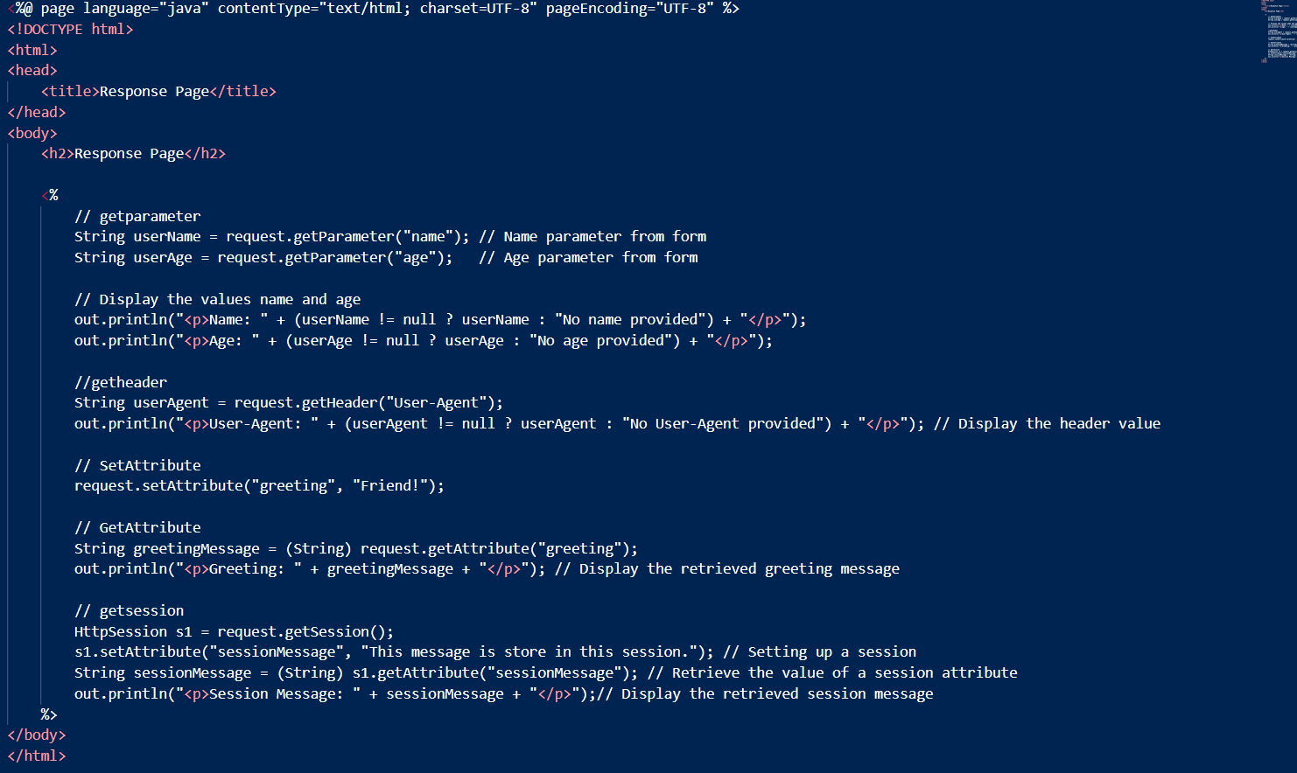
Request.jsp (CODE)

Slide 13
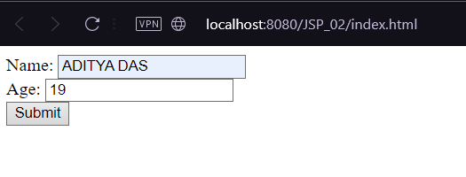
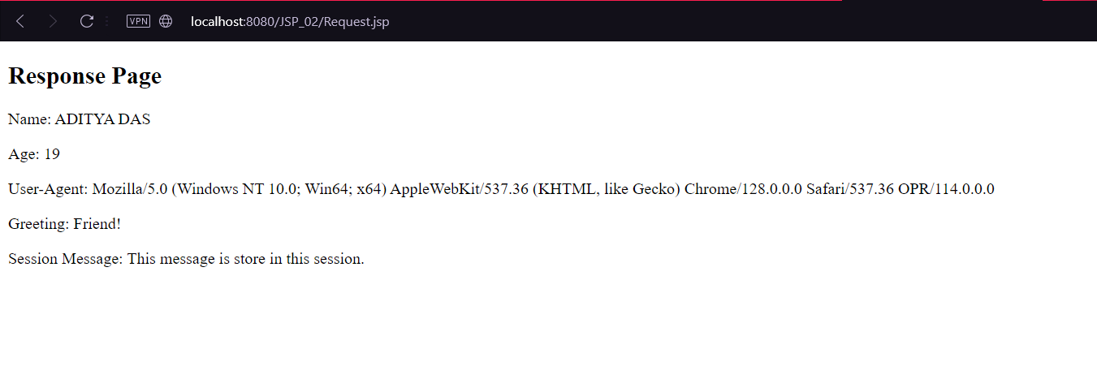
index.html,Request.jsp (output)

Slide 14
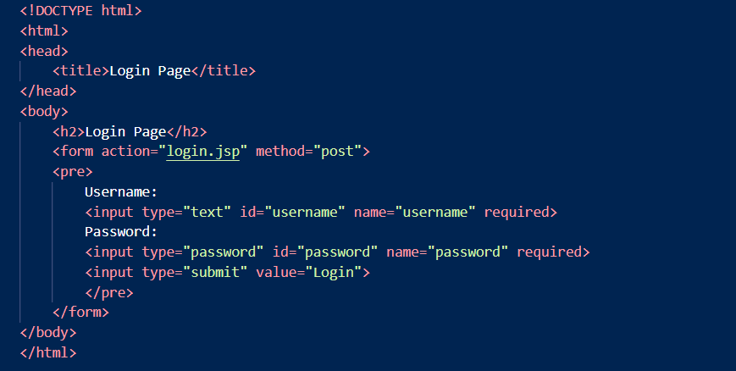
login.html(CODE)

Slide 15
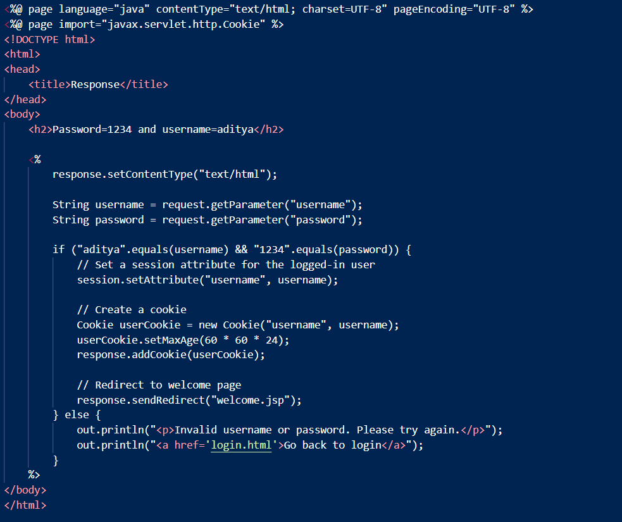
login.jsp(CODE)

Slide 16
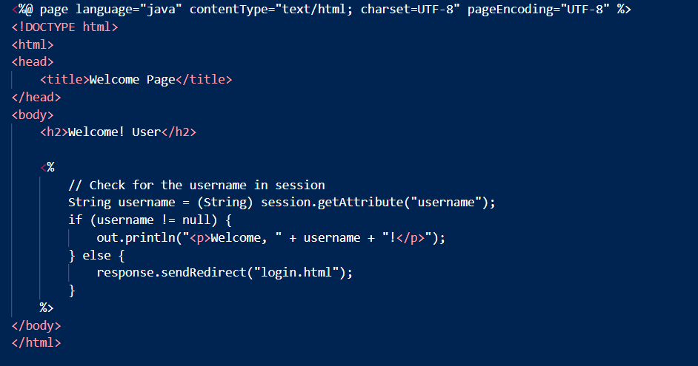
welcome.jsp(CODE)

Slide 17
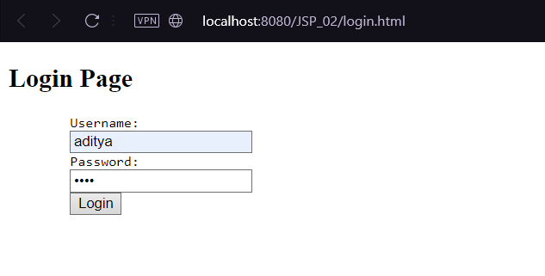
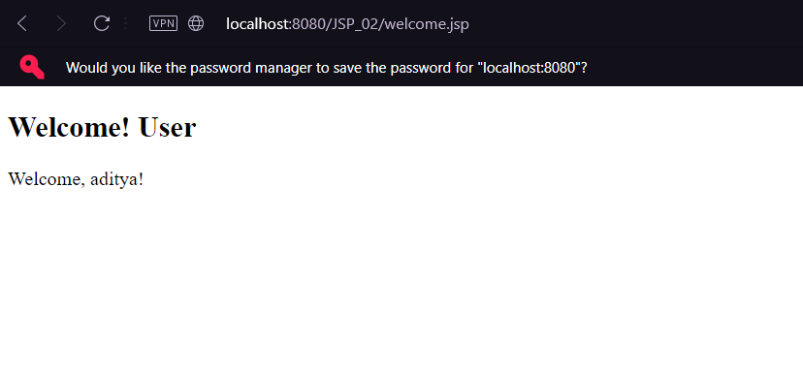
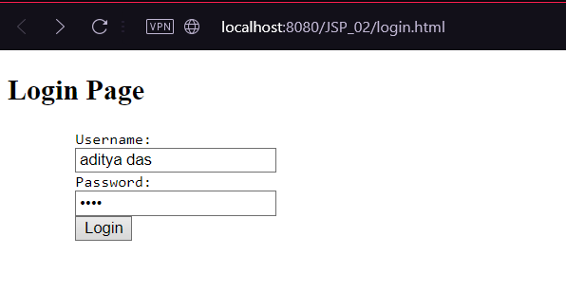
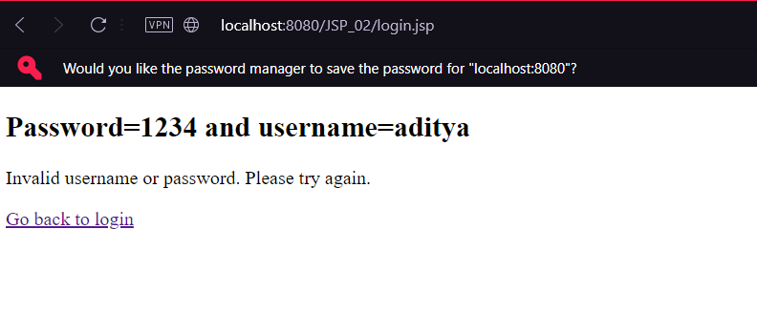
login.html,login.jsp,welcome.jsp(output)

Slide 18
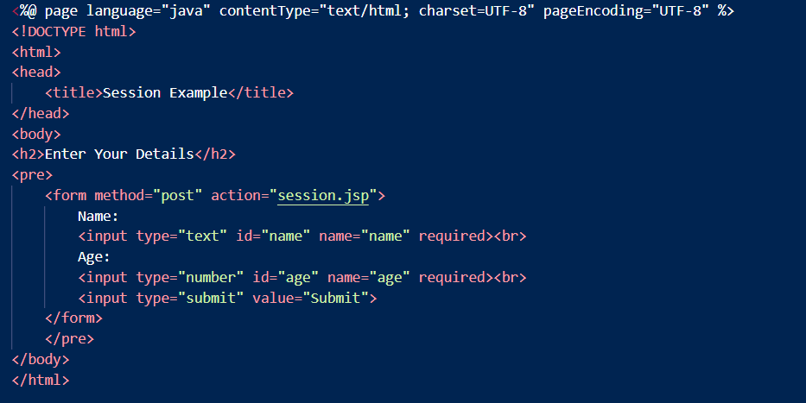
index.jsp(CODE)

Slide 19
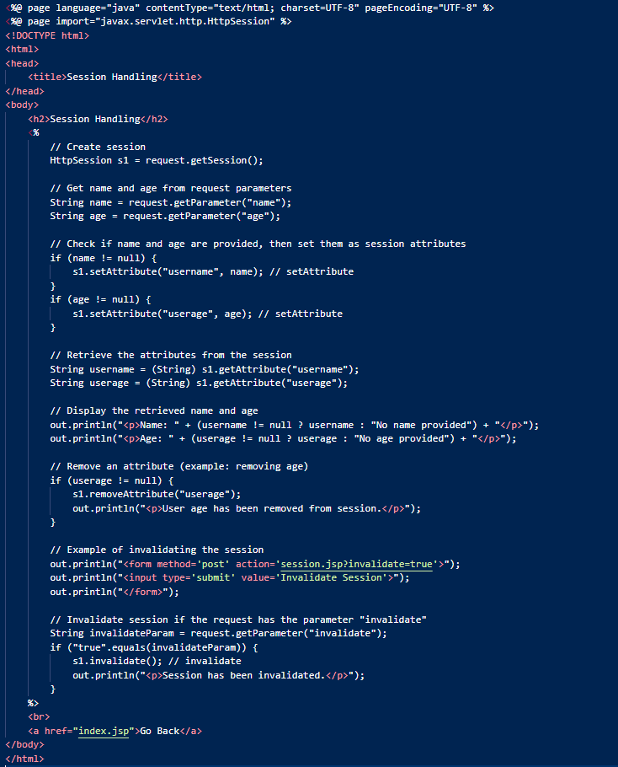
session.jsp(CODE)

Slide 20
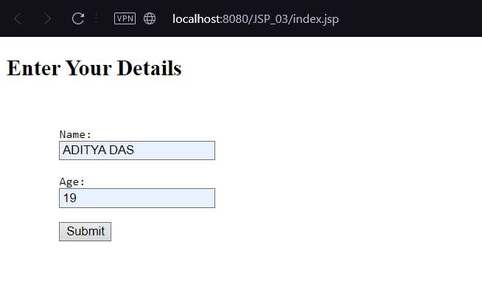
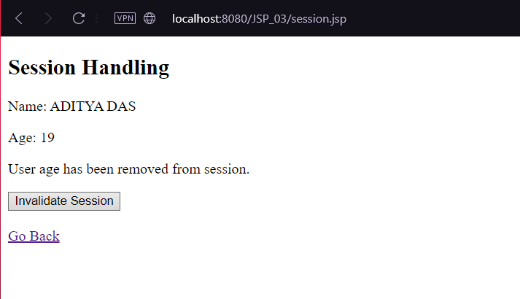
index.jsp,session.jsp(output)

Slide 21
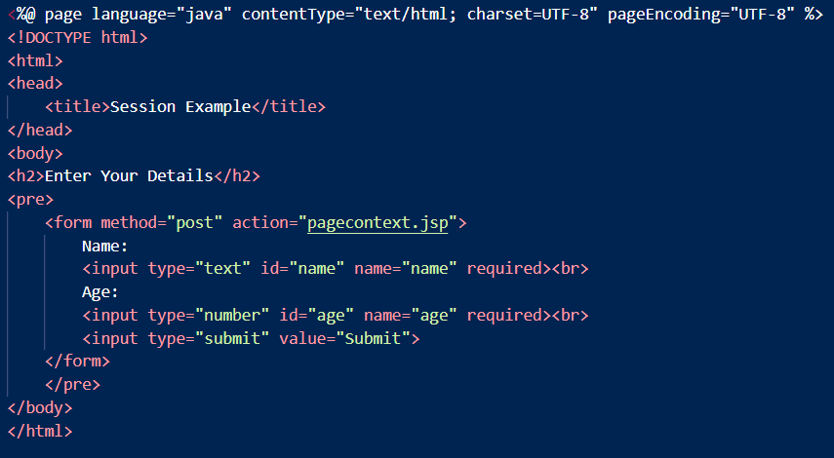
index1.jsp(CODE)

Slide 22
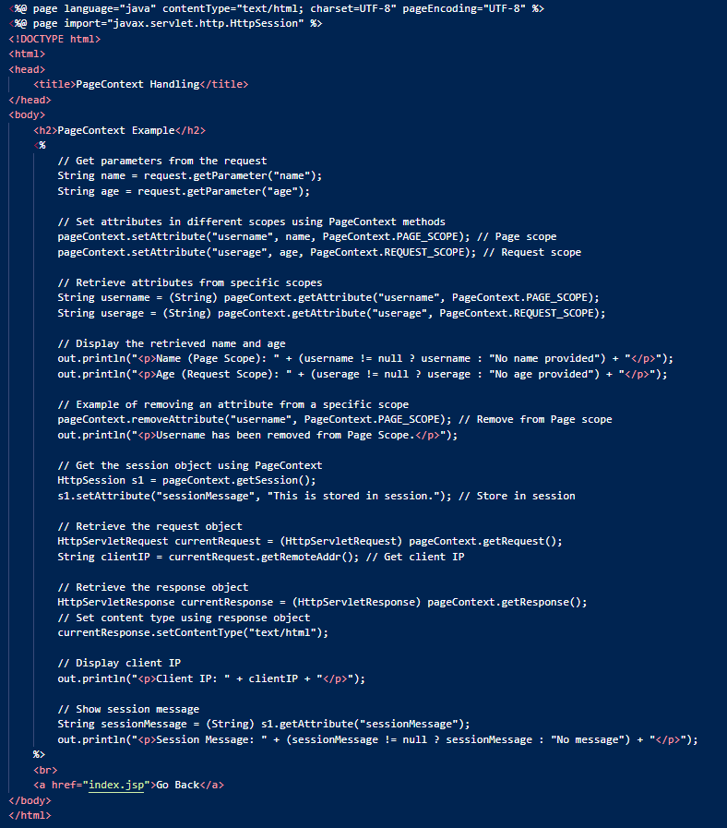
pagecontext.jsp (CODE)

Slide 23
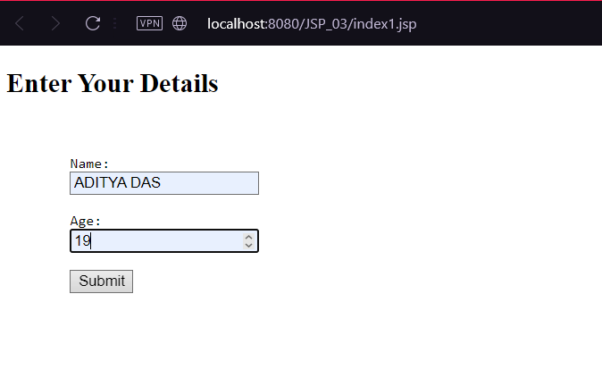
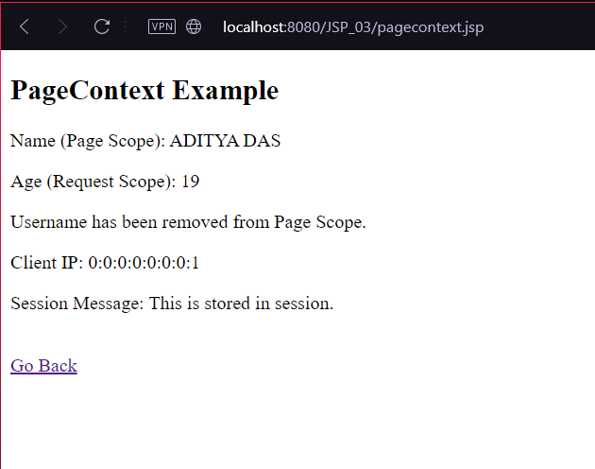
index1.jsp,pagecontext.jsp (OUTPUT)

Slide 24
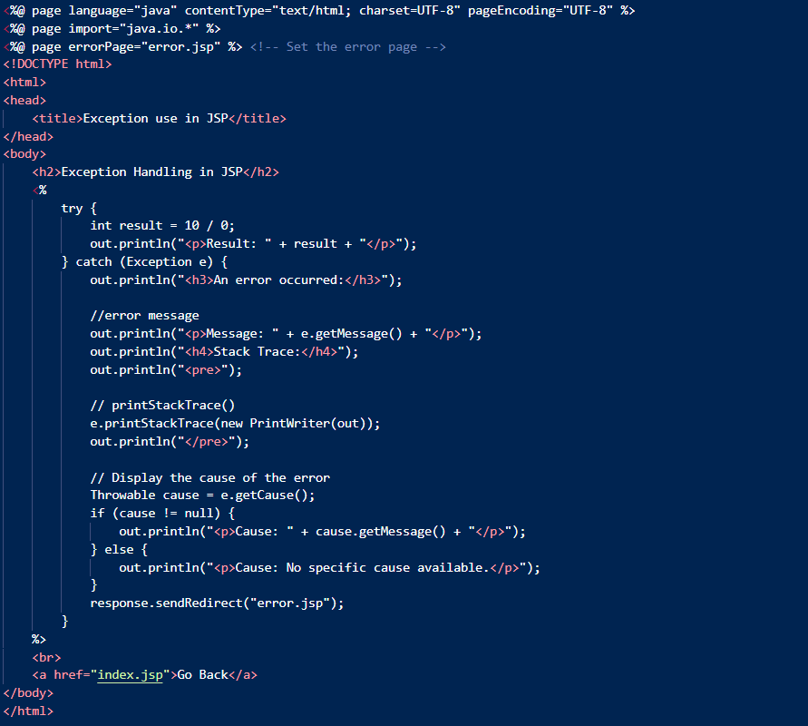
ExceptionHandling.jsp (CODE)

Slide 25
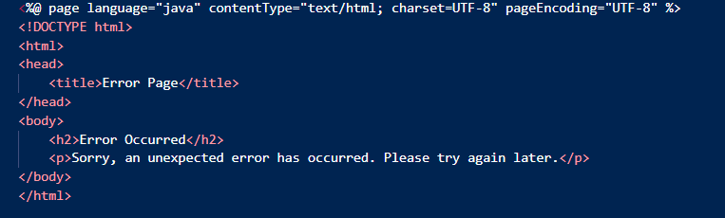
error.jsp (CODE)

Slide 26
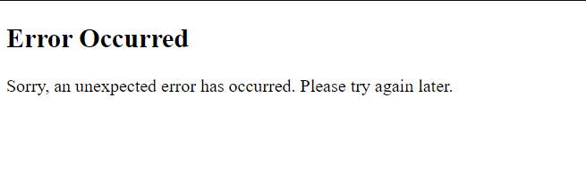
exceptionHandling.jsp,error.jsp (output)
It’s a part of exceptionHandling.jsp

Slide 27
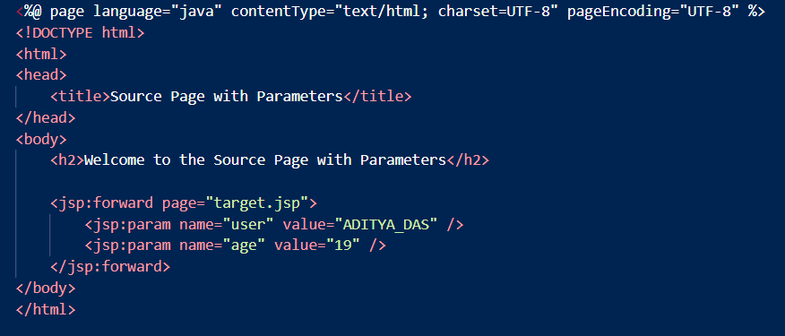
forward.jsp (CODE)

Slide 28
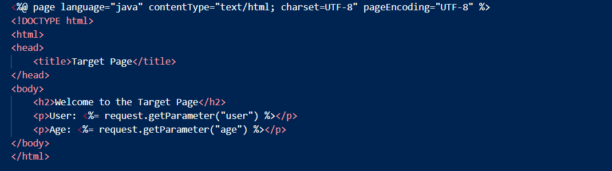
target.jsp (CODE)

Slide 29
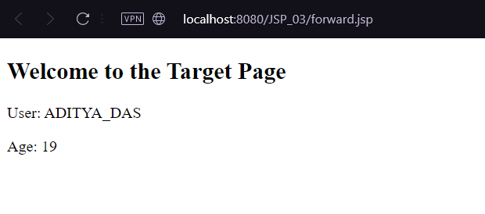
forward.jsp,target.jsp(output)

Slide 30
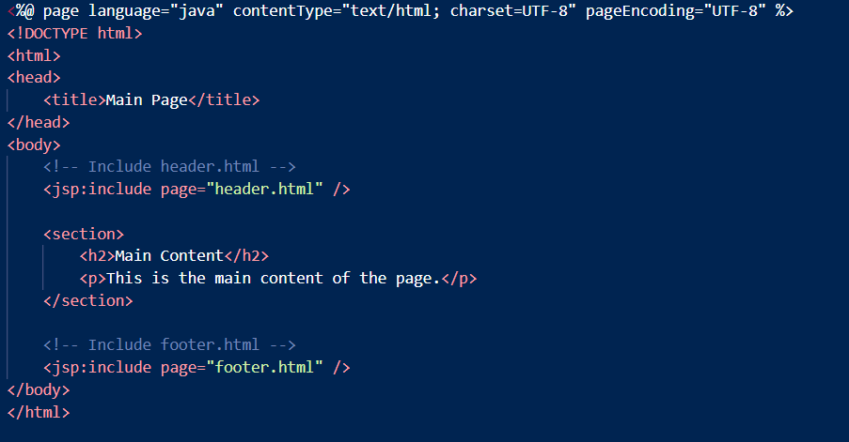
include.jsp (CODE)

Slide 31
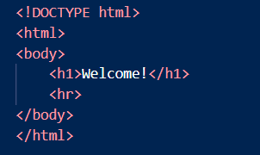
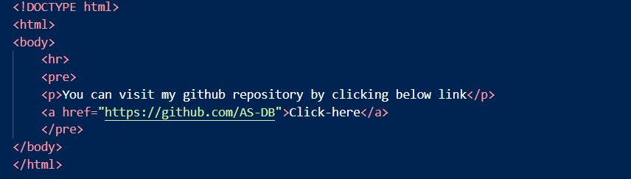
header.html, footer.html (CODE)

Slide 32
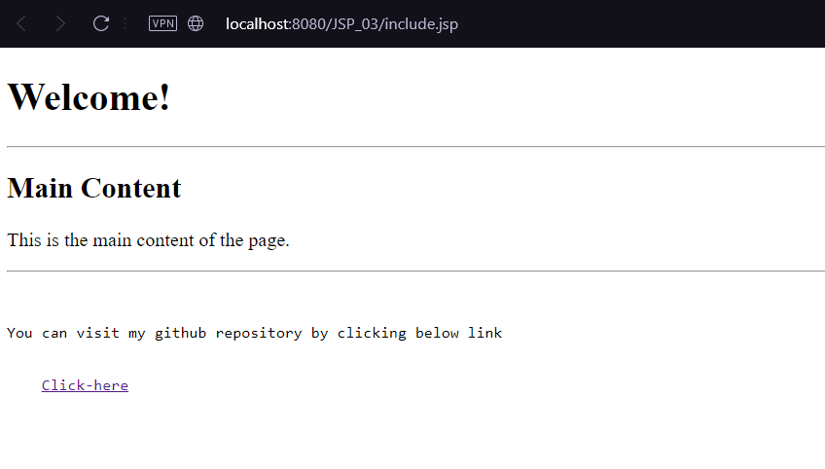
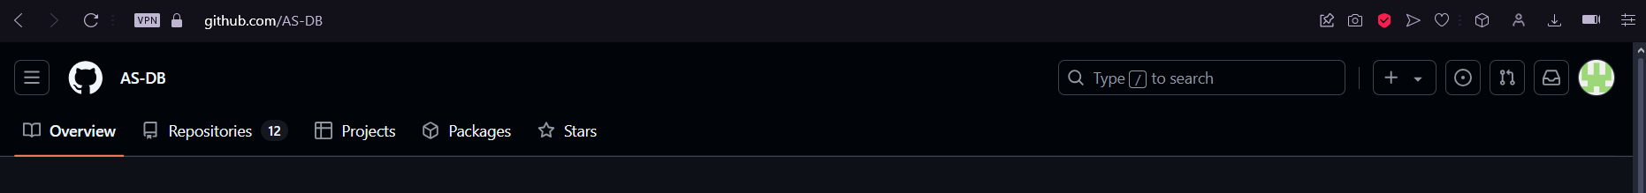
include.jsp,header.html,footer.html(output)
After clicking click-here it will redirect to below page.

